Slide 1
With Dr. Hector

Slide 2
Topics
Classes
More about Passing Arguments
Instance Fields and Methods
Constructors
A BankAccount Class
Classes, Variables, and Scope
Packages and import Statements
Focus on Object Oriented Design: Finding the Classes and their Responsibilities

Slide 3
Classes
In an object-oriented programming language, like Java, you create programs that are made of objects.
In software, an object has two capabilities:
An object can store data.
An object can perform operations.
The data stored in an object are commonly called attributes or fields.
The operations that an object can perform are called methods.

Slide 4
Strings as Objects
A primitive data type can only store data, as it has no other built-in capabilities.
An object can store data and perform operations on that data.
In addition to storing strings, String objects have numerous methods that perform operations on the strings they hold.

Slide 5
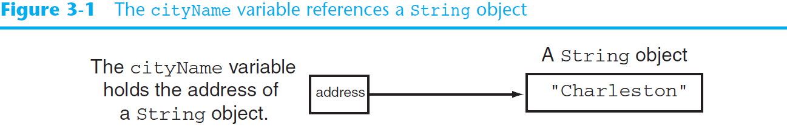
Strings as Objects (cont’d)
From chapter 2, we learned that a reference variable contains the address of an object.

Slide 6
Strings as Objects (cont’d)
The length() method of the String class returns and integer value that is equal to the length of the string.
int stringLength = cityName.length();
The variable stringLength will contain 10 after this statement since the string "Charleston" has 10 characters.
Primitives can not have methods that can be run whereas objects can.

Slide 7
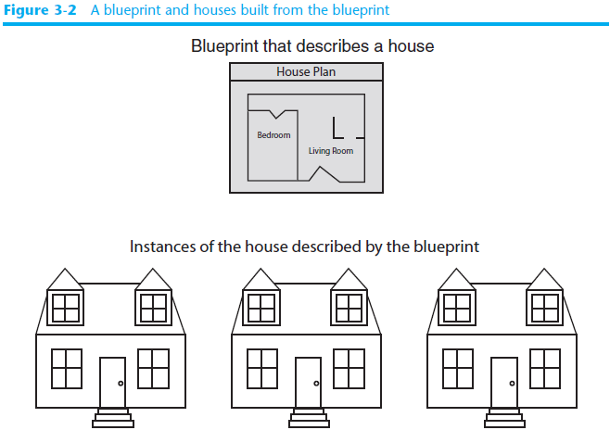
Classes and Instances
Many objects can be created from a class.
Each object is independent of the others.

Slide 8
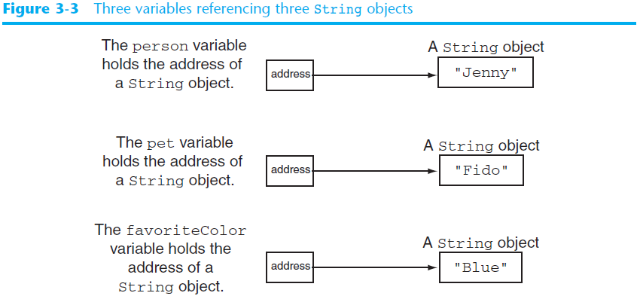
Classes and Instances (cont’d)

Slide 9
Classes and Instances (cont’d)
Each instance of the String class contains different data.
The instances are all share the same design.
Each instance has all of the attributes and methods that were defined in the String class.
Classes are defined to represent a single concept or service.

Slide 10

Access Modifiers
An access modifier is a Java key word that indicates how a field or method can be accessed.
There are three Java access modifiers:
public
private
protected

Slide 11
Access Modifiers
public: This access modifier states that any other class can access the resource.
private: This access modifier indicates that only data within this class can access the resource.
protected: This modifier indicates that only classes in the current package or a class lower in the class hierarchy can access this resource.
These will be explained in greater detail later.

Slide 12
Access Modifiers
Classes that need to be used by other classes are typically made public.
If there is more than one class in a file, only one may be public and it must match the file name.
Class headers have a format:
AccessModifier class ClassName
{
Class Members
}

Slide 13
Encapsulation
Classes should be as limited in scope as needed to accomplish the goal.
Each class should contain all that is needed for it to operate.
Enclosing the proper attributes and methods inside a single class is called encapsulation.
Encapsulation ensures that the class is self-contained.

Slide 14
Designing a Class
When designing a class, decisions about the following must be made.
what data must be accounted for
what actions need to be performed
what data can be modified
what data needs to be accessible
any rules as to how data should be modified
Class design typically is done with the aid of a Unified Modeling Language (UML) diagram.

Slide 15
UML Class Diagram
A UML class diagram is a graphical tool that can aid in the design of a class.
The diagram has three main sections.
Class Name
UML diagrams are easily converted
to Java class files. There will be more
about UML diagrams a little later.
Attributes
Methods
The class name should concisely reflect what the class represents.

Slide 16
Attributes
The data elements of a class define the object to be instantiated from the class.
The attributes must be specific to the class and define it completely.
Example: A rectangle is defined by
length
width
The attributes are then accessed by methods within the class.

Slide 17
Data Hiding
Another aspect of encapsulation is the concept of data hiding.
Classes should not only be self-contained but they should be self-governing as well.
Classes use the private access modifier on fields to hide them from other classes.
Classes need methods to allow access and modification of the class’ data.

Slide 18
Methods
The class’ methods define the actions that an instance of the class can perform
Methods headers have a format:
AccessModifier ReturnType MethodName(Parameters)
{
// Method body.
}
Methods that need to be used by other classes should be made public.

Slide 19
Methods
The attributes of a class might need to be:
changed
accessed
calculated
The methods that change and access attributes are called accessors and mutators.

Slide 20
Accessors and Mutators
Because of the concept of data hiding, fields in a class are private.
The methods that retrieve the data of fields are called accessors.
The methods that modify the data of fields are called mutators.
Each field that the programmer wishes to be viewed by other classes needs an accessor.
Each field that the programmer wishes to be modified by other classes needs a mutator.

Slide 21
Accessors and Mutators
For the Rectangle example, the accessors and mutators are:
setLength : Sets the value of the length field.
public void setLength(double len) …
setWidth : Sets the value of the width field.
public void setWidth(double w) …
getLength : Returns the value of the length field.
public double getLength() …
getWidth : Returns the value of the width field.
public double getWidth() …
Other names for these methods are getters and setters.

Slide 22
Stale Data
Some data is the result of a calculation.
Consider the area of a rectangle.
length times width
It would be impractical to use an area variable here.
Data that requires the calculation of various factors has the potential to become stale.
To avoid stale data, it is best to calculate the value of that data within a method rather than store it in a variable.

Slide 23
Stale Data
Rather than use an area variable in a rectangle class:
public double getArea()
{
return length * width;
}
This dynamically calculates the value of the rectangle’s area when the method is called.
Now, any change to the length or width variables will not leave the area of the rectangle stale.

Slide 24
UML Data Type and Parameter Notation
UML diagrams are language independent.
UML diagrams use an independent notation to show return types, access modifiers, etc.
Rectangle
Access modifiers are denoted as:
+ public
- private
# protected
- width : double
+ setWidth(w : double) : void

Slide 25
UML Data Type and Parameter Notation
UML diagrams are language independent.
UML diagrams use an independent notation to show return types, access modifiers, etc.
Variable types are placed after the variable name, separated by a colon.
Rectangle
- width : double
+ setWidth(w : double) : void

Slide 26
UML Data Type and Parameter Notation
UML diagrams are language independent.
UML diagrams use an independent notation to show return types, access modifiers, etc.
Rectangle
Method return types are placed after the method declaration name, separated by a colon.
- width : double
+ setWidth(w : double) : void

Slide 27
UML Data Type and Parameter Notation
UML diagrams are language independent.
UML diagrams use an independent notation to show return types, access modifiers, etc.
Method parameters are shown inside the parentheses using the same notation as variables.
Rectangle
- width : double
+ setWidth(w : double) : void

Slide 28
Converting the UML Diagram to Code
Putting all of this information together, a Java class file can be built easily using the UML diagram.
The UML diagram parts match the Java class file structure.
class header
{
Attributes
Methods
}
ClassName
Attributes
Methods

Slide 29
Converting the UML Diagram to Code
The structure of the class can be compiled and tested without having bodies for the methods. Just be sure to put in dummy return values for methods that have a return type other than void.
public class Rectangle
{
private double width;
private double length;
public void setWidth(double w)
{
}
public void setLength(double len)
{
}
public double getWidth()
{ return 0.0;
}
public double getLength()
{ return 0.0;
}
public double getArea()
{ return 0.0;
}
}
Rectangle
width : double
length : double
+ setWidth(w : double) : void
+ setLength(len : double): void
+ getWidth() : double
+ getLength() : double
+ getArea() : double

Slide 30
Converting the UML Diagram to Code
Once the class structure has been tested, the method bodies can be written and tested.
public class Rectangle
{
private double width;
private double length;
public void setWidth(double w)
{ width = w;
}
public void setLength(double len)
{ length = len;
}
public double getWidth()
{ return width;
}
public double getLength()
{ return length;
}
public double getArea()
{ return length * width;
}
}
Rectangle
width : double
length : double
+ setWidth(w : double) : void
+ setLength(len : double): void
+ getWidth() : double
+ getLength() : double
+ getArea() : double

Slide 31
Class Layout Conventions
The layout of a source code file can vary by employer or instructor.
Generally the layout is:
Attributes are typically listed first
Methods are typically listed second
The main method is sometimes first, sometimes last.
Accessors and mutators are typically grouped.

Slide 32
A Driver Program
An application in Java is a collection of classes that interact.
The class that starts the application must have a main method.
This class can be used as a driver to test the capabilities of other classes.
In the Rectangle class example, notice that there was no main method.

Slide 33
A Driver Program
public class RectangleDemo
{
public static void main(String[] args)
{
Rectangle r = new Rectangle();
r.setWidth(10);
r.setLength(10);
System.out.println("Width = "
+ r.getWidth());
System.out.println("Length = "
+ r.getLength());
System.out.println("Area = "
+ r.getArea());
}
}
public class Rectangle
{
private double width;
private double length;
public void setWidth(double w)
{ width = w;
}
public void setLength(double len)
{ length = len;
}
public double getWidth()
{ return width;
}
public double getLength()
{ return length;
}
public double getArea()
{ return length * width;
}
}
This Rectangle Demo class is a Java application that uses the Rectangle class.

Slide 34
Multiple Arguments
Methods can have multiple parameters.
The format for a multiple parameter method is:
AccessModifier ReturnType MethodName(ParamType ParamName,
ParamType ParamName,
etc)
{
}
Parameters in methods are treated as local variables within the method.
Example: MultipleArgs.java

Slide 35
Arguments Passed By Value
In Java, all arguments to a method are passed “by value”.
If the argument is a reference to an object, it is the reference that is passed to the method.
If the argument is a primitive, a copy of the value is passed to the method.

Slide 36
Instance Fields and Methods
Fields and methods that are declared as previously shown are called instance fields and instance methods.
Objects created from a class each have their own copy of instance fields.
Instance methods are methods that are not declared with a special keyword, static.

Slide 37
Instance Fields and Methods
Instance fields and instance methods require an object to be created in order to be used.
Example: RoomAreas.java
Note that each room represented in this example can have different dimensions.
Rectangle kitchen = new Rectangle();
Rectangle bedroom = new Rectangle();
Rectangle den = new Rectangle();

Slide 38
Constructors
Classes can have special methods called constructors.
Constructors are used to perform operations at the time an object is created.
Constructors typically initialize instance fields and perform other object initialization tasks.

Slide 39
Constructors
Constructors have a few special properties that set them apart from normal methods.
Constructors have the same name as the class.
Constructors have no return type (not even void).
Constructors may not return any values.
Constructors are typically public.
Example: ConstructorDemo.java
Example: RoomConstructor.java

Slide 40
The Default Constructor
If a constructor is not defined, Java provides a default constructor.
It sets all of the class’ numeric fields to 0.
It sets all of the class’ boolean fields to false.
It sets all of the class’ reference variables, the default constructor sets them to the special value null.
The default constructor is a constructor with no parameters.
Default constructors are used to initialize an object in a default configuration.

Slide 41
Constructors in UML
Rectangle
Notice there is no
return type listed
for constructors.
width : double
length : double
+Rectangle(len:double, w:double)
+ setWidth(w : double) : void
+ setLength(len : double): void
+ getWidth() : double
+ getLength() : double
+ getArea() : double
In UML, the most common way constructors are defined is:

Slide 42
The String Class Constructor
One of the String class constructors accepts a string literal as an argument.
This string literal is used to initialize a String object.
For instance:
String name = new String("Michael Long");
String name = "Michael Long";

Slide 43
The String Class Constructor
This creates a new reference variable name that points to a String object that represents the name “Michael Long”
Because they are used so often, Strings can be created with a shorthand:
String name = "Michael Long";

Slide 44
The BankAccount Example
BankAccount
balance : double
interestRate : double
interest : double
+BankAccount(startBalance:double,
intRate :double):
+ deposit(amount : double) : void
+ withdrawl(amount : double) : void
+ addInterest() : void
+ getBalance() : double
+ getInterest() : double

Slide 45
Classes, Variables and Scope
The list below shows the scope of a variable depending on where it is declared.
Inside a method:
Visible only within that method.
Called a local variable.
In a method parameter:
Called a parameter variable.
Same as a local variable
Visible only within that method.
Inside the class but not in a method:
Visible to all methods of the class.
Called an instance field.

Slide 46
Shadowing
A parameter variable is, in effect, a local variable.
Within a method, variable names must be unique.
A method may have a local variable with the same name as an instance field.
This is called shadowing.
The local variable will hide the value of the instance field.
Shadowing is discouraged and local variable names should not be the same as instance field names.

Slide 47
Packages and import Statements
A package is a group of related classes.
The classes in the Java API are organized into packages.
For example, the Scanner class is in the java.util package.
Many of the API classes must be imported before they can be used. For example, the following statement is required to import the Scanner class:
import java.util.Scanner;
This statement appears at the top of the program's source code.

Slide 48
Packages and import Statements
Explicit import Statements
An explicit import statement specifies a single class: import java.util.Scanner;
Wildcard import Statements
A wildcard import statement imports all of the classes in a package: import java.util.*;

Slide 49
Packages and import Statements
The java.lang package
Automatically imported into every Java program.
Contains general classes such as String and System.
You do not have to write an import statement for the java.lang package.

Slide 50
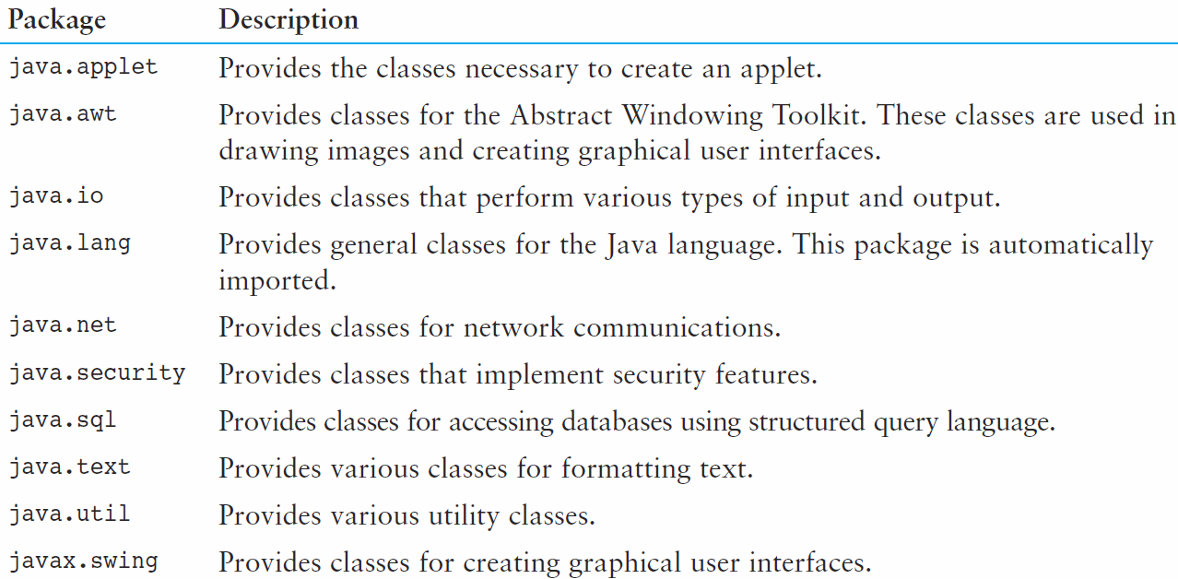
Packages and import Statements
You will use other packages as you learn more about Java.
Table 3-2 lists a few examples.

Slide 51
Object Oriented Design Finding Classes and Their Responsibilities
Finding the classes
Get written description of the problem domain
Identify all nouns, each is a potential class
Refine list to include only classes relevant to the problem
Identify the responsibilities
Things a class is responsible for knowing
Things a class is responsible for doing
Refine list to include only classes relevant to the problem

Slide 52
Object Oriented Design Finding Classes and Their Responsibilities
Identify the responsibilities
Things a class is responsible for knowing
Things a class is responsible for doing
Refine list to include only classes relevant
to the problem

